Slide 1
Poverty Factors and Predictability
By Kishan Patel

Slide 2
Intro: Data
Who: 12,600 People Surveyed
Where: Across 7 different countries
Measure: Poverty Probability Index (PPI)- % of target households living below the poverty line ($2.50/day threshold)

Slide 3
Question: What factors attribute to poverty?
Purpose: If we can define these poverty factors, we can focus on allocating resources to them to create a better economic system as a whole.

Slide 4
General Demographics

Slide 5
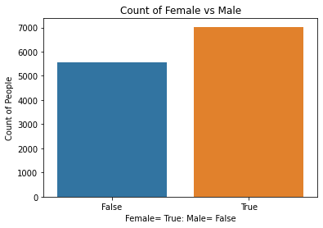
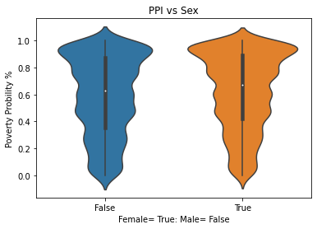
Sex
-56% Female
-44% Male
-For both sexes, there are a higher amount of people
who are above 80% PPI followed by an increase at 50% mark.

Slide 6
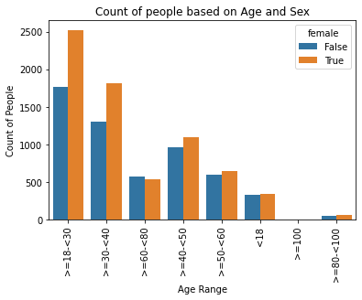
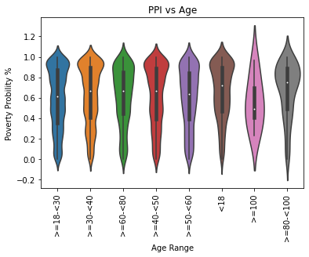
Age
-34% >=18-<30
-25% >=30-<40
-16% >=40-<50
-From ages 18-79, there are a higher amount of people
With PPI above 80%.
-Starting at age 80, more people start to have a lower PPI.

Slide 7
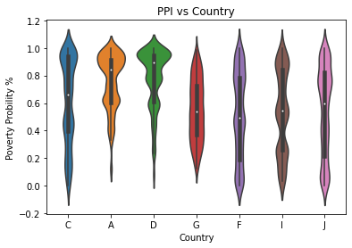
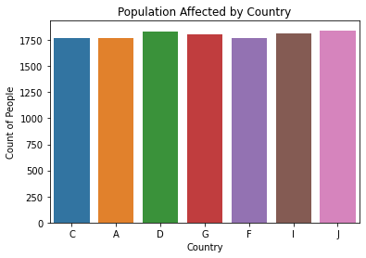
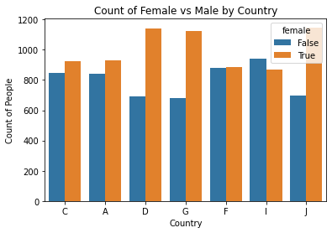
Country
-There was an about equal amount of people surveyed per country.
-Counties D, G and J seemed to have the most sex discrepancies.
-Countries A and D followed by C had more people with a higher PPI,
With country G being more uniform with its PPI.

Slide 8
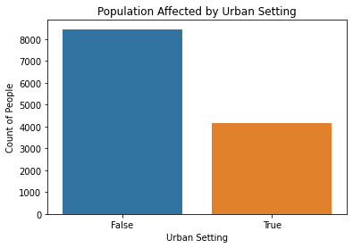
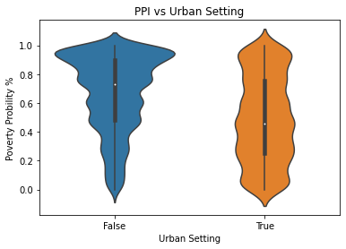
Urban Setting
-False 67%
-True 32%
-Most of the population was not urban.
-Those who weren’t, had a higher pop with a PPI
>80%.
-Those who were, had a uniform amount of PPI,
Highest ranged from 20-50%.

Slide 9
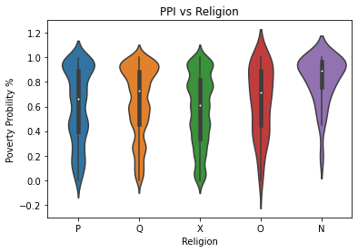
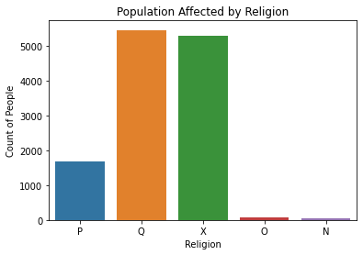
Religion
Q 43%
X 42%
P 13%
-Pop of religions P and Q seem to spike at a PPI >80%
-Pop of religion X and 2 seem to but more uniform
-Most Pop of religion N seem to be concentrated at
a higher PPI.

Slide 10
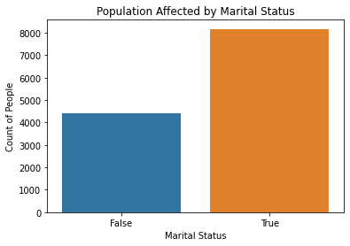
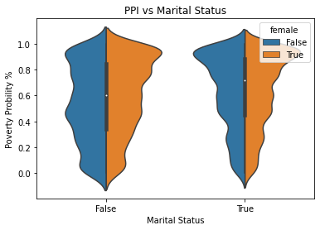
Marital Status
-True 65%
-False 35%
- There were more married people than single.
Of the married, there was an equal amount of people with
a higher PPI >80%.
Of the unmarried, males were more uniform with a peak
at 40% PPI and another at 70%. Females were seeing higher
above 70%

Slide 11
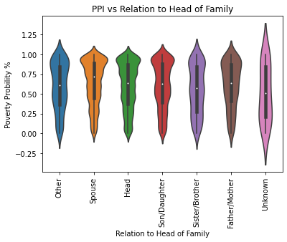
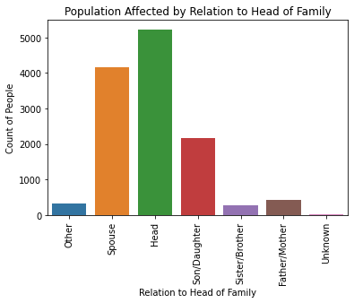
Family Member Status
Head 43%
Spouse 33%
Son/Daughter 17%
-Most reported that they were Head of the house or the spouse of the head.
- Most showed having a higher PPI >75%, with Sister/Brother status being more uniform throughout.

Slide 12
Education

Slide 13
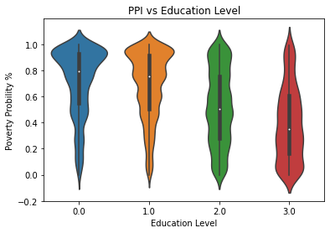
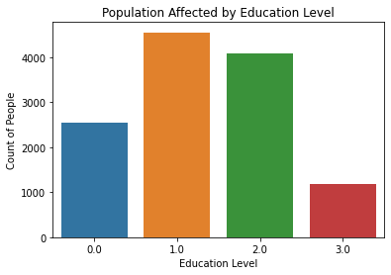
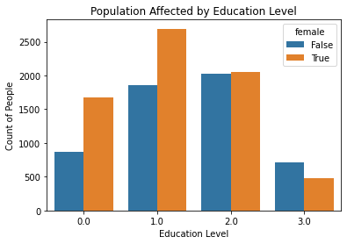
Education Level
1.0 37%
2.0 33%
0.0 21%
3.0 10%
-There were more people with type 1 and 2 education.
-Females seemed to have gone under more schooling but more males have a higher (3) education.
-People with lower education seem to have a higher PPI score.

Slide 14
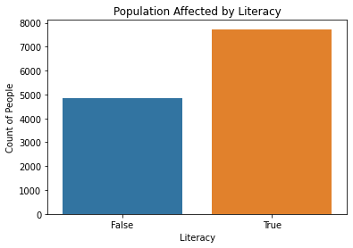
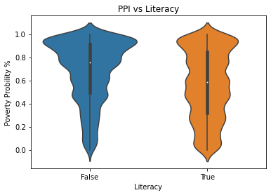
Literacy
True 61%
False 39%
-People who cold not read had a higher PPI,
while people who could were more uniform.

Slide 15
FINANCE

Slide 16
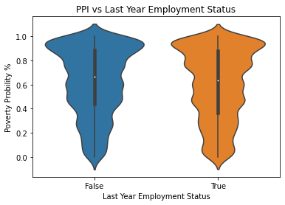
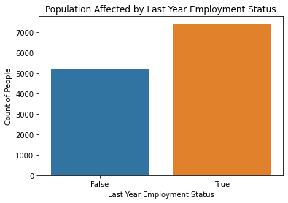
Previous Year Employment
True 59%
False 41%
More people were employed the previous year than not.
Those who were not employed had a higher PPI spiking at 50% and then again at 90%
Previous Year Employment Category:
Employed 59%
Housewife or student 29%
Other 5%
Unemployed 4%
Retired or disabled 3%
Previous Year Employment Type:
Not working 36%
Self employed 25%
Irregular seasonal 19%
Salaried 16%
Other 5%

Slide 17
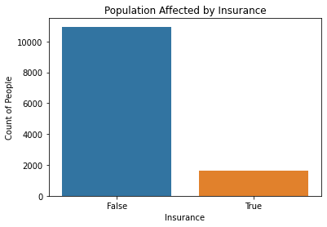
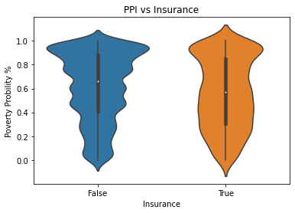
Insurance
False 87%
True 13%
-Only 13% had insurance, those who did seemed to have more of a lower PPI score

Slide 18
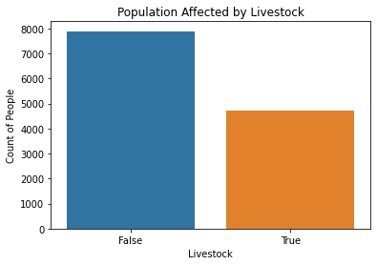
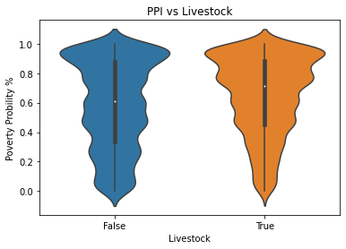
Income: From Livestock
False 63%
True 37%
-More people who got their main income from livestock had a PPI score >70%

Slide 19
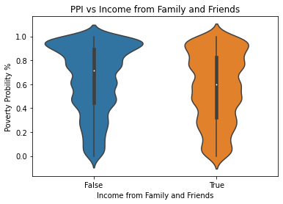
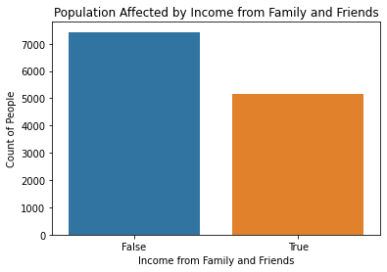
Income: From Family and Friends
False 59%
True 41%
-People who had financial help from family and friends seemed to have more uniform PPI scores vs who didn’t have help.

Slide 20
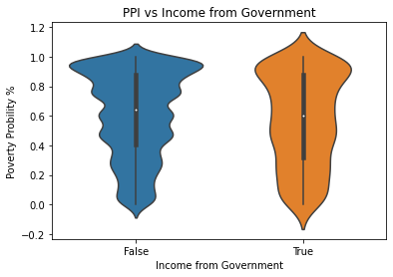
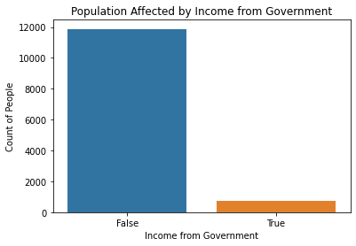
Income: From Government
False 94%
True 6%
- Only 6% of the population received help form the government. Those who did seemed to have more uniform PPI scores but still peaked above >80%.

Slide 21
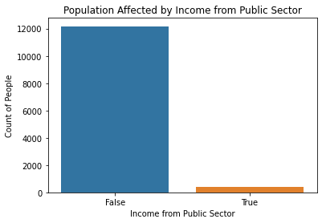
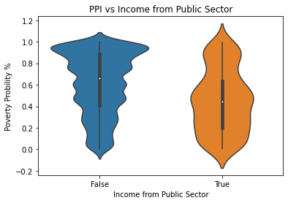
Income: From Public Sector
False 97%
True 3%
-Only 3% received help from a private sector. Most who did had a PPI <50%

Slide 22
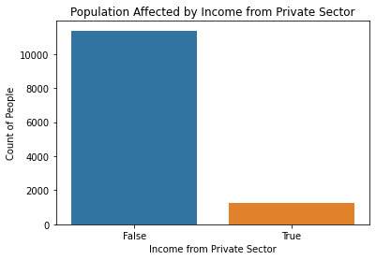
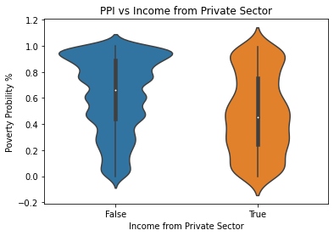
Income: From Private Sector
False 90%
True 10%
-Only 10% received help from a private sector. Most who did had a PPI <50%

Slide 23
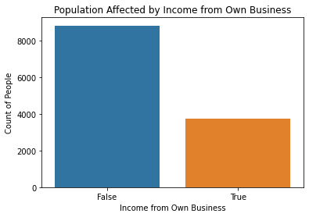
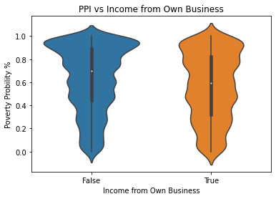
Income: From Own Business
False 70%
True 30%
-People who had their own business had lower PPI

Slide 24
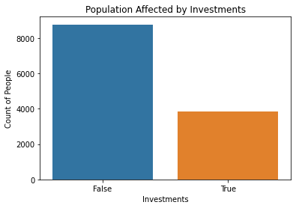
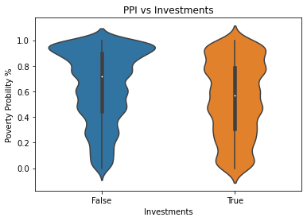
Investments
False 70%
True 30%
-Those who invested money had a lower PPI score

Slide 25
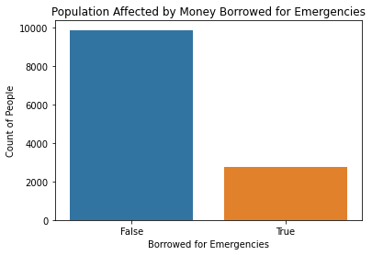
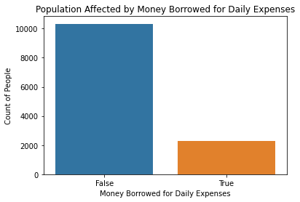
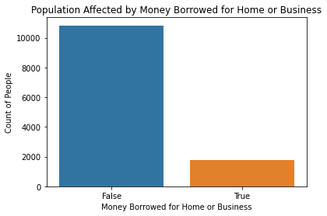
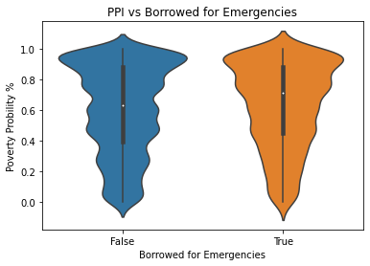
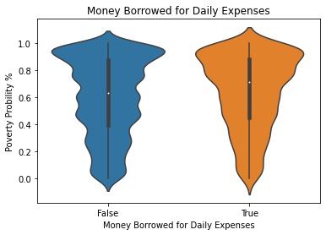
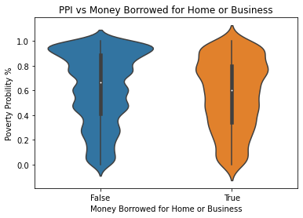
Money Borrowed
-Most who borrowed money still had a high PPI score

Slide 26
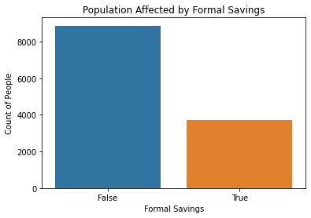
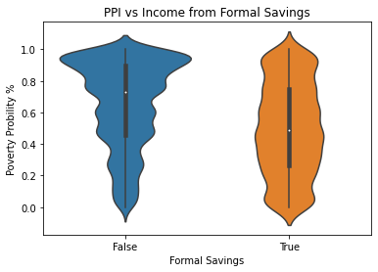
Formal Savings
False 70%
True 30%
-Only 30% of the population had savings.
-Most who did, maintained a peak PPI <60%

Slide 27

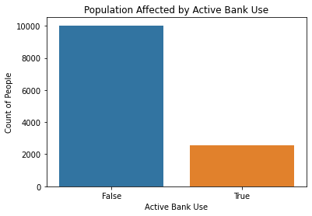
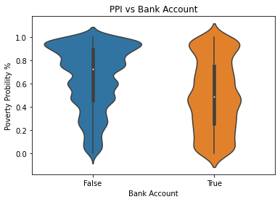
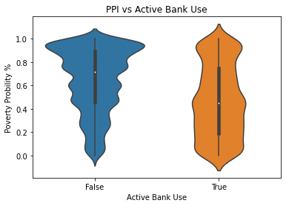
Bank Account vs Active Use
Lower PPI with Bank Account
Even Lower PPI with Active Use
False 72% True 28%
False 80% True 20%

Slide 28
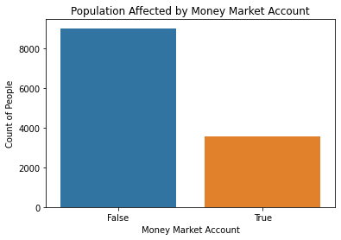



Money Market Account vs Active Use
Lower PPI with MM Account
Even Lower PPI with Active Use
*MM account- Pays a higher interest rate than regular bank account
False 72% True 28%
False 76% True 24%

Slide 29




Non-Bank Financial Institutions vs Active Use
Lower PPI with NBFI Account
No change with Active Use
*NBFI= brokers/dealers, investment advisers, mutual funds, hedge funds, or commodity traders, casinos, clubs etc.
False 92% True 8%
False 94% True 6%

Slide 30


Financial Activities
0 47%
1 16%
2 11%
3 9%
4 7%
5 4%
-Higher the PPI, less big financial activities a person can be involved in

Slide 31
Technology Communication

Slide 32




Phone
People with less phone availability, had a higher PPI score.
People who owned 2 phones had a lower PPI score
0 35%
2 24%
1 24%
3 16%
2 65%
1 18%
0 18%

Slide 33




Call and Text Capability
People with calling capability had a bit lower PPI score.
People with texting capability had even lower PPI score.
True 77% False 23%
False 51% True 49%

Slide 34




Internet and Transaction Capability
-Access to internet and able to buy dramatically reduces PPI
False 75% True 25%
False 72% True 28%

Slide 35
Summary: Demographics
1. Sex- Females are more likely to be in poverty.
2. Age- No major discrepancies.
3. Country- Countries A, D and C are more likely to be in poverty.
4. Urban Settings- Non-urban people are more likely to be in poverty.
5. Religion- Religion N was more likely to be in poverty followed by P and Q
6. Marital Status- Non married Females and married couples are more likely to be in poverty.
7. Family Member Status- Every member besides sister/brother field were likely to be in poverty.
8. Financial Activity- Higher the PPI= less activities a person can do.

Slide 36
Summary: Large Reduction to Poverty
1. Income: Public Sector- Little given out but dramatically reduced chance of poverty.
2. Income: Private sector- Little given out but also helped a lot to reduce chance of poverty.
3. Formal Savings- Having savings dramatically reduced chance of poverty.
4. Bank Account and Active use- dramatically reduced chance of poverty.
5. Money Market Account and Active Use - dramatically reduces chance of poverty.
6. Internet and Transaction Capability- dramatically reduces chance of poverty.

Slide 37
Summary: Moderate Reduction to Poverty
1. Education- People with lower education level are more likely to be in poverty.
2. Literacy- Inability to read linked to likely more poverty.
3. Insurance- People with insurance reduces the chance of poverty.
4. Income: Family and Friends- Help reduces the chance of poverty
5. Phone- Access to/owning 2 phones reduces chances of poverty.
6. Call and Text Capability- Both reduces changes of poverty, esp being able to text.

Slide 38
Summary Very Little Reduction to No Change in Poverty
1. Income: Government- Help given by government was very sparce but did help a little.
2. NBFI- No change to very little reduction in chances of poverty.
3. Income: Own Business- Helped reduce chance of poverty a little.
4. Investments- Helped reduce chance of poverty a little.
5. Year Employment- Being employed reduces the chance of poverty but not a substantial amount.

Slide 39
Summary: Increased Chance of Poverty
1. Income: Livestock- Livestock seems to increase the chance of poverty.
2. Money Borrowed- borrowing increased the chance of poverty unless it was for home or business reasons.

